Slide 1
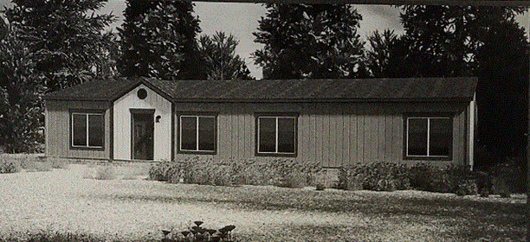
Tentative Map Case No. WTM16-002
Washoe County
Board of Adjustment
April 6, 2017
Carmelo Barajas-Ceja

Slide 2
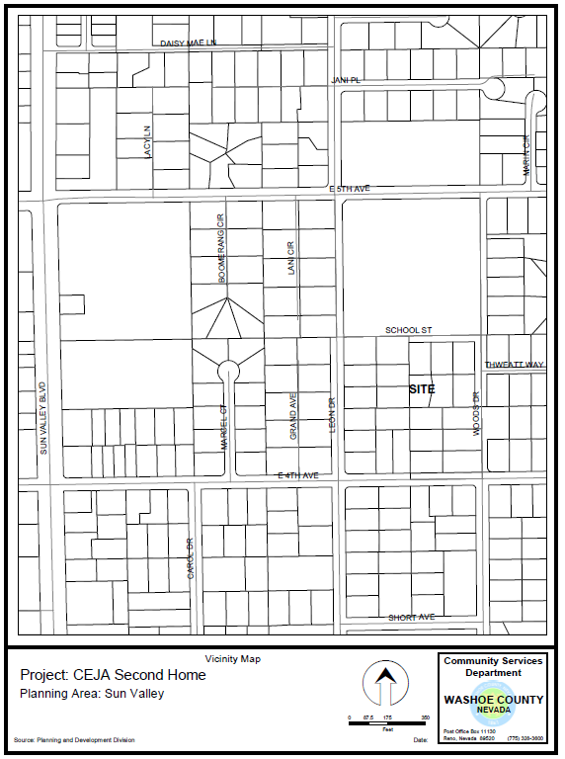
Vicinity Map
West of Woods Dr. and north of E. 4th Avenue

Slide 3
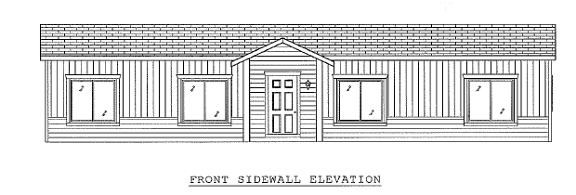
Proposed Dwelling
Property
Size: 0.347 Acres (15,115 s.f.)
Zoning: Medium Density Suburban (MDS)
Existing Residence:
800 square feet
Proposed Residence:
1,680 square feet
(See Elevation Below)

Slide 4
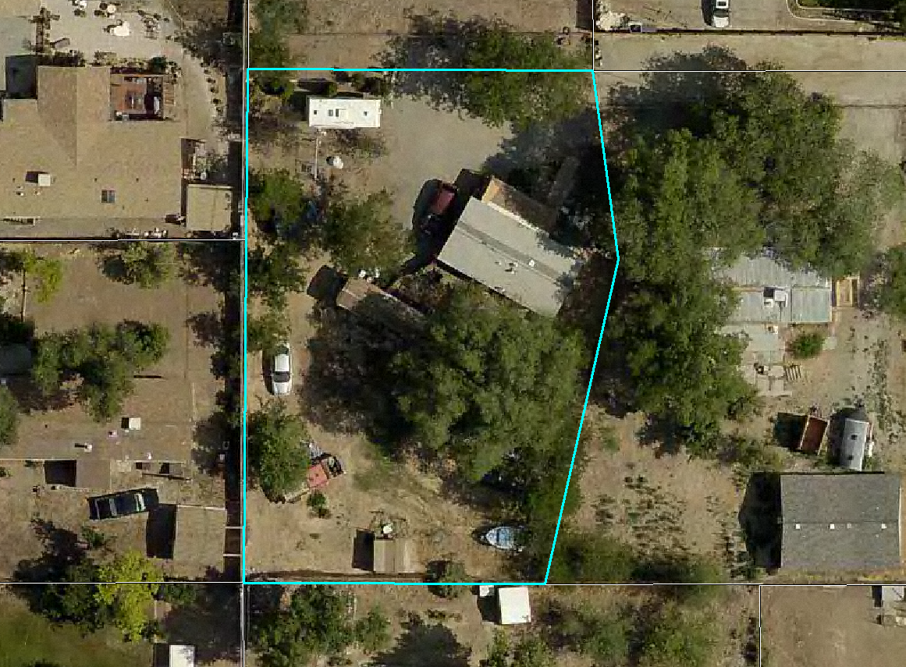
Site Plan
Existing Dwelling
Proposed Dwelling

Slide 5
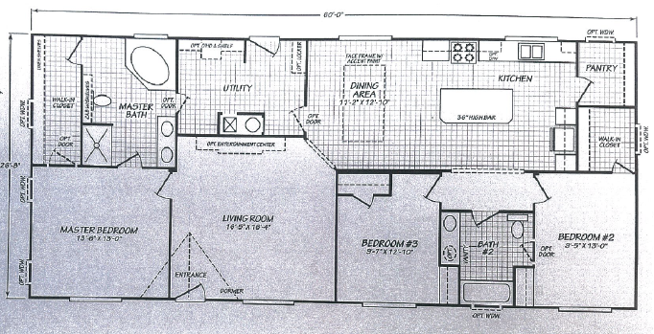
Floor Plan

Slide 6
Community Meeting
Sun Valley Citizen Advisory Board (SVCAB) Meeting – April 3, 2017
  Concern was raised about the dirt driveway;
  SVCAB recommended approval (four in favor; one opposed)

Slide 7
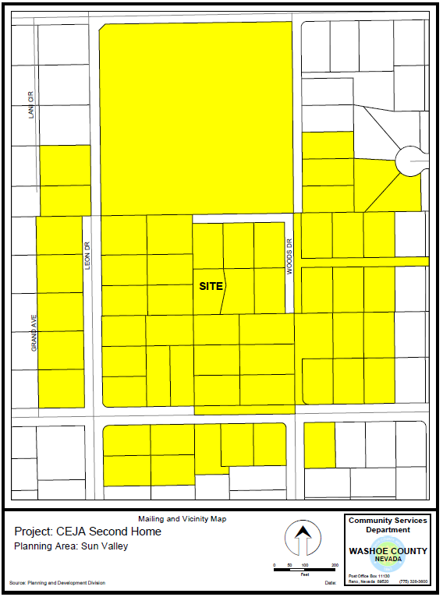
Notice Map
500 feet from Property
58 Different Property Owners
Meets all noticing requirements of Article 810

Slide 8
Findings
1. Consistency. That the proposed use is consistent with the action programs, policies, standards and maps of the Master Plan and the Sun Valley Area Plan;
2. Improvements. That adequate utilities, roadway improvements, sanitation, water supply, drainage, and other necessary facilities have been provided, the proposed improvements are properly related to existing and proposed roadways, and an adequate public facilities determination has been made in accordance with Division Seven;
3. Site Suitability. That the site is physically suitable for a detached accessory dwelling, and for the intensity of such a development;
4. Issuance Not Detrimental. That issuance of the permit will not be significantly detrimental to the public health, safety or welfare; injurious to the property or improvements of adjacent properties; or detrimental to the character of the surrounding area;
5. Effect on a Military Installation. Issuance of the permit will not have a detrimental effect on the location, purpose or mission of the military installation.

Slide 9
Possible Motion for WSUP17-0002
I move that, after giving reasoned consideration to the information contained in the staff report and information received during the public hearing, the Washoe County Board of Adjustment approve with conditions Special Use Permit Case Number WSUP17-0002 for Carmelo Barajas-Ceja, having made all five findings in accordance with Washoe County Code Section 110.810.30.

